Slide 1
Basic Electrical and Electronics Engineering
UniT 5
Dr. Sonam Shrivastava/ Assistant Professor (Sr.) /SELECT

Slide 2

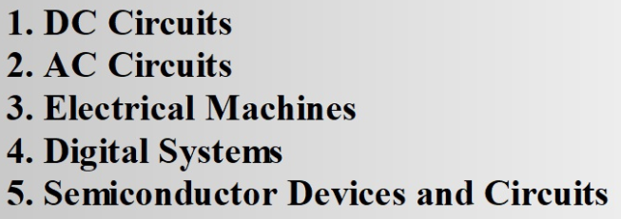

Slide 3
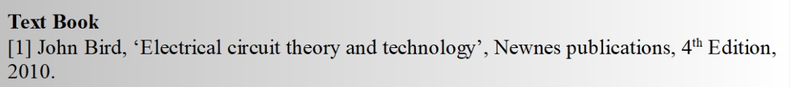
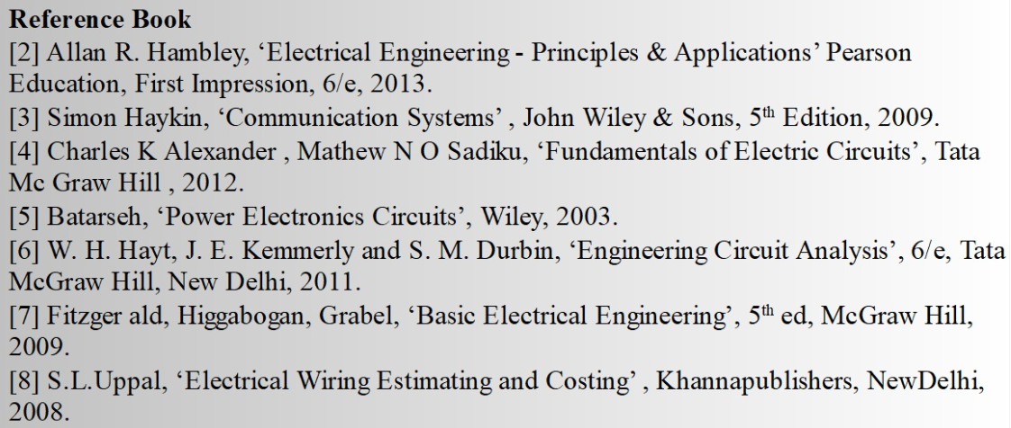
Books

Slide 4
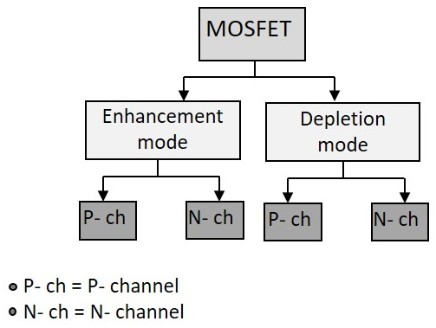
Metal Oxide Semiconductor Field Effect Transistor or MOSFET
The primary difference between the two types of transistors is the fact that the BJT is a current-controlled device while MOSFET is a voltage-controlled device.
Types of MOSFET Devices: The MOSFET is classified into two types such as follows. • Depletion mode MOSFET (Normally On) • Enhancement mode MOSFET (Normally Off)

Slide 5
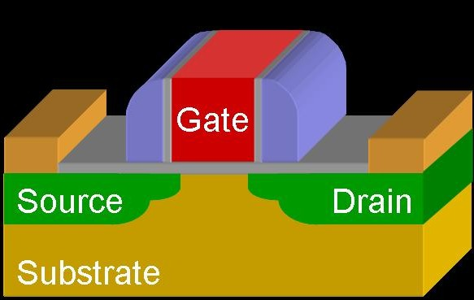
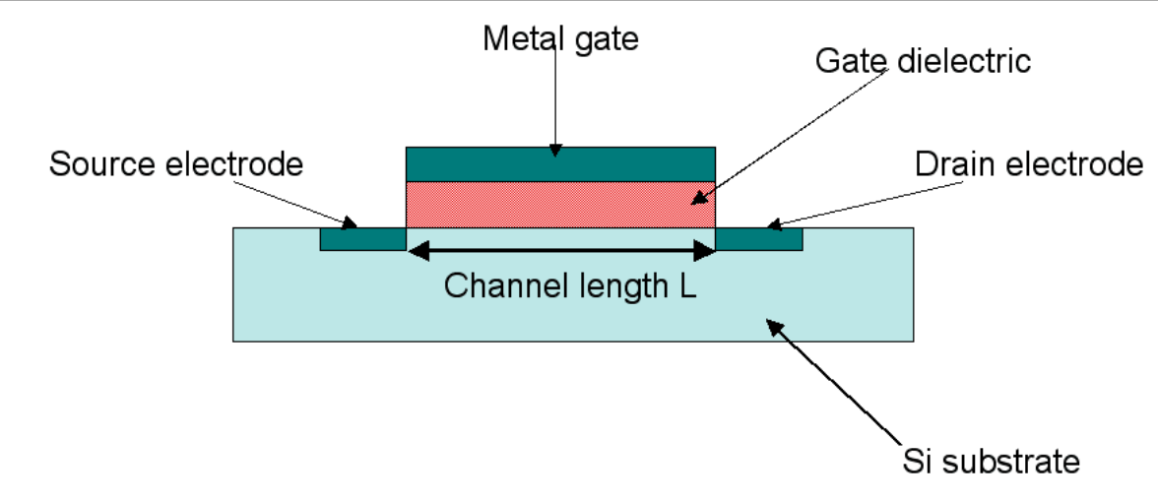
The MOSFET is a unipolar device depending solely on either electron (n-channel) or hole (p-channel) conduction.
It is a 4 terminal device namely Drain (D), Source (S), Substrate (Body), and Gate (G).
The Drain and Source terminals are heavily doped regions.
The gate terminal is connected on top of the oxide layer.
The body of the MOSFET is frequently connected to the source terminal so making it a three terminal device like BJT.

Slide 6
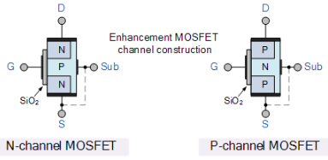
The MOSFET works by electronically varying the width of a channel along which charge carriers flow (electrons or holes).
The charge carriers enter the channel at source and exit via the drain.
The width of the channel is controlled by the voltage on an electrode is called gate which is located between source and drain.
It is insulated from the channel by an extremely thin layer of metal oxide.
If the MOSFET is an n-channel or nMOS FET, then the source and drain are heavily doped 'n' regions and the body is a 'p' region.
If the MOSFET is a p-channel or pMOS FET, then the source and drain are heavily doped 'p' regions and the body is a 'n' region

Slide 7
Enhancement mode MOSFET
Enhancement-type MOSFETS are MOSFETs that are normally off.
When you connect an enhancement-type MOSFET, no current flows from drain to source when no voltage is applied to its gate.
This is why it is called a normally off device. There is no current flow without a gate voltage.
However, if a voltage is applied to the gate lead of the MOSFET, the drain-source channel becomes less resistive. As the gate-source voltage increases more and more, the current flowing from drain to source increases more and more, until maximum current is flowing from drain to source.
An enhancement-type MOSFET is so named an enhancement device, because as the voltage to the gate increases, the current increases more and more, until at maximum level.
An enhancement-type MOSFET behaves very similar in action to a bipolar junction transistor.

Slide 8
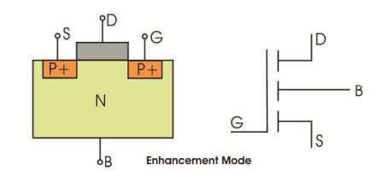
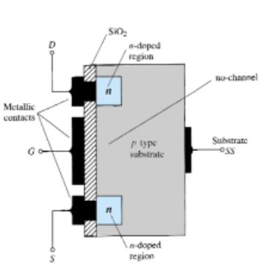
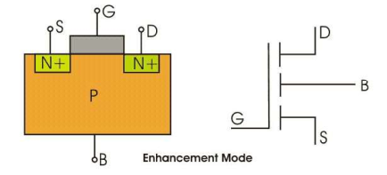
Enhancement mode P-channel MOSFET
N-dopped region
No channel
Enhancement mode N-channel MOSFET
Substrate SS

Slide 9
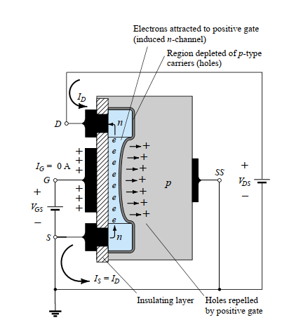
Working of Enhancement mode n-channel MOSFET

Slide 10
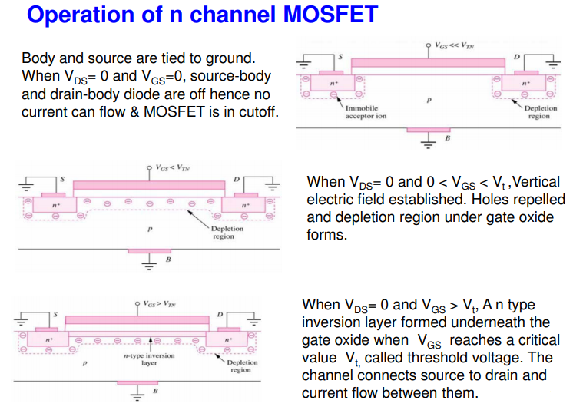
Working of Enhancement mode n-channel MOSFET

Slide 11
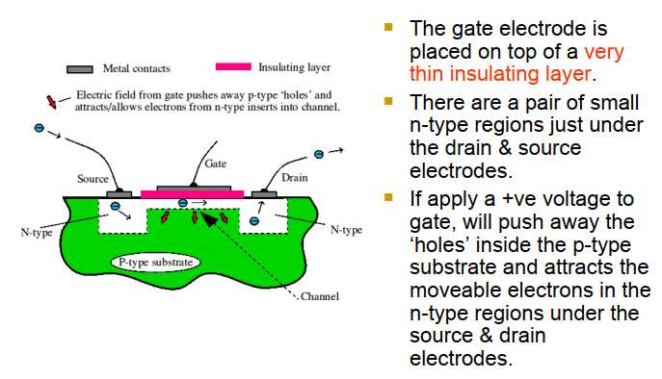
Working of Enhancement mode n-channel MOSFET

Slide 12
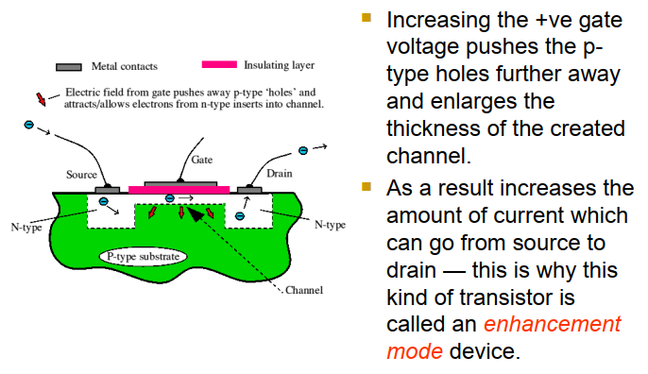
Working of Enhancement mode n-channel MOSFET

Slide 13
Depletion mode MOSFET
Depletion-type MOSFETS are MOSFETs that are normally ON.
The construction of an enhancement-type MOSFET is quite similar to that of the depletion-type MOSFET, except for the absence of a channel between the drain and source terminals.
In a depletion-type MOSFET, current flows from drain to source without any gate voltage applied. This is why it is called a normally on device.
There is current flow even without a gate voltage. With a depletion-type MOSFET, maximum current flows from drain to source when no difference in voltage exists between the gate and source terminals (VGS=0).
However, if a voltage is applied to the gate lead of the MOSFET, the drain-source channel becomes more resistive. As the gate-source voltage increases more and more, the current flowing from drain to source decreases more and more, until all current flow from drain to source ceases.
A depletion-type MOSFET is so named a depletion device, because as the voltage to the gate increases, the current depletes more and more, until it ceases to flow at all.

Slide 14
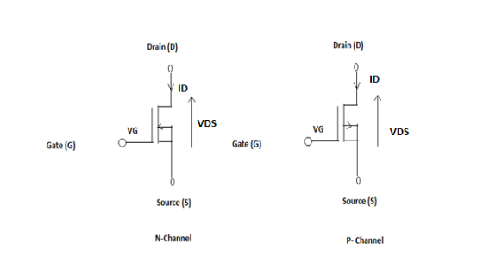
Depletion mode MOSFET
When there is no voltage on the gate, the channel shows its maximum conductance. As the voltage on the gate is either positive or negative, the channel conductivity decreases.
Depletion Type – the FET requires the Gate-Source voltage, ( V_{GS} ) to switch the device “OFF”. The depletion mode MOSFET is equivalent to a “Normally Closed” switch (ON).

Slide 15
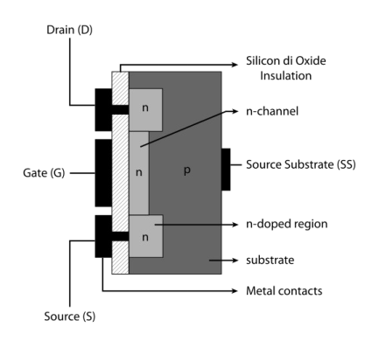
Depletion mode N channel MOSFET NMOS

Slide 16
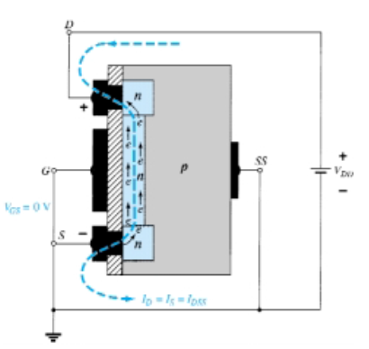
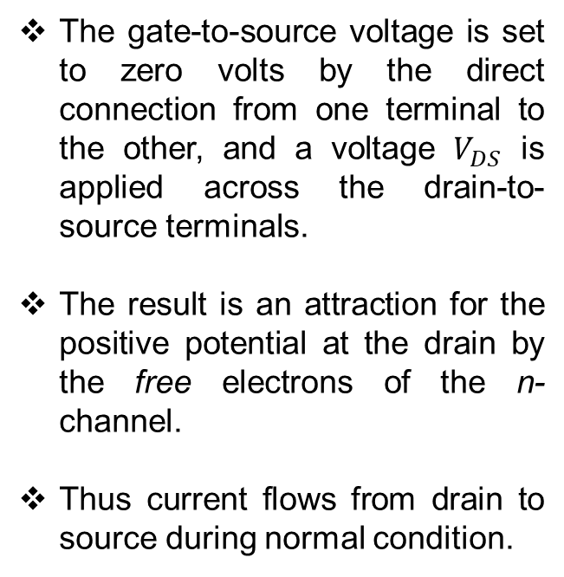

Basic operation of Depletion mode N channel MOSFET NMOS
$$For V_{GS}=0$$
The gate-to-source voltage is set to zero volts by the direct connection from one terminal to the other, and a voltage $V_{DS}$ is applied across the drain-to-source terminals.
The result is an attraction for the positive potential at the drain by the free electrons of the n-channel.
Thus current flows from drain to source during normal condition.

Slide 17
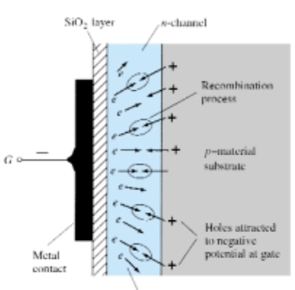
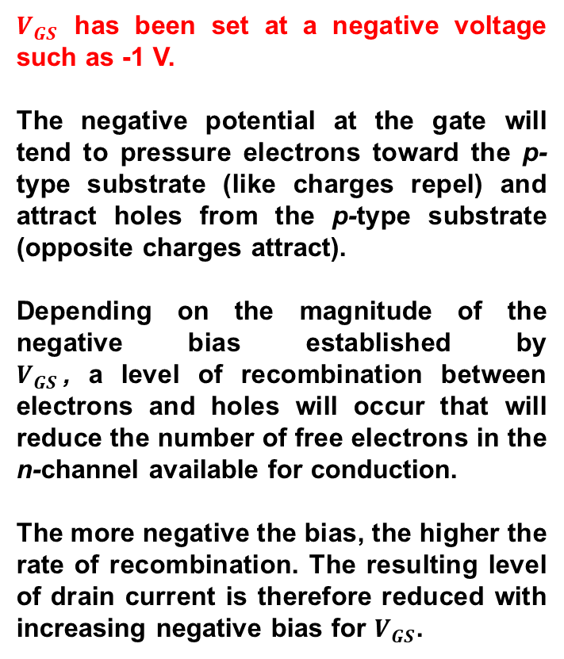

Reduction in free carrier in channel due to a negative potential at the gate terminal
${SiO}_{2}$ layer
N-channel
$V_{GS}$ has been set at a negative voltage such as -1 V.
The negative potential at the gate will tend to pressure electrons toward the p-type substrate (like charges repel) and attract holes from the p-type substrate (opposite charges attract).
Depending on the magnitude of the negative bias established by $V_{GS}$, a level of recombination between electrons and holes will occur that will reduce the number of free electrons in the n-channel available for conduction.
The more negative the bias, the higher the rate of recombination. The resulting level of drain current is therefore reduced with increasing negative bias for $V_{GS}$.
Recombination process
P- material substrate
Holes attracted to negative potential at gate
Metal contact
Electrons repelled by negative potential at gate.

Slide 18
S. No. | Topic | Link
1 | PN Junction diode | https://www.youtube.com/watch?v=btOIDQeMrMg&t=199s
2 | Zener Diode | https://www.youtube.com/watch?v=V5nWu8EbMhI&t=33s
3 | BJT | https://www.youtube.com/watch?v=fIvZen2tq_w
4 | Rectifier | https://www.youtube.com/watch?v=quyqtaKIr78
5 | MOSFET | https://www.youtube.com/watch?v=Bfvyj88Hs_o

Slide 19
Thank you

